Slide 1
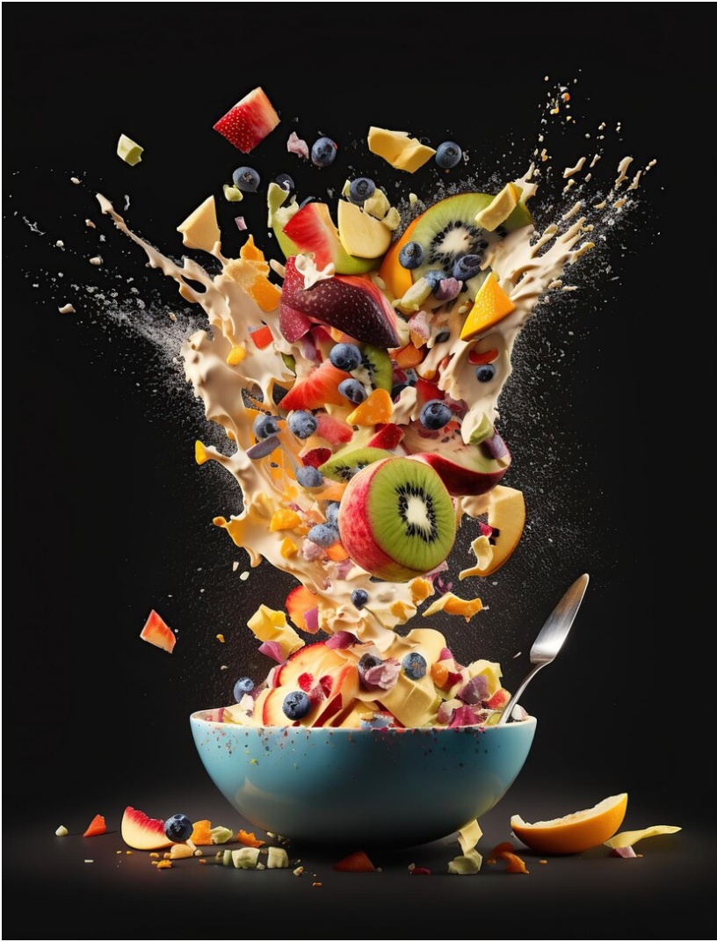
> CODE CRAFTERS
KNOWYOURCIBO
Eat Rate Curate!

Slide 2




Why do we need it ?
Lot of people are from different places
Could easily get confused between so many food items
Many outside people visit the campus

Slide 3
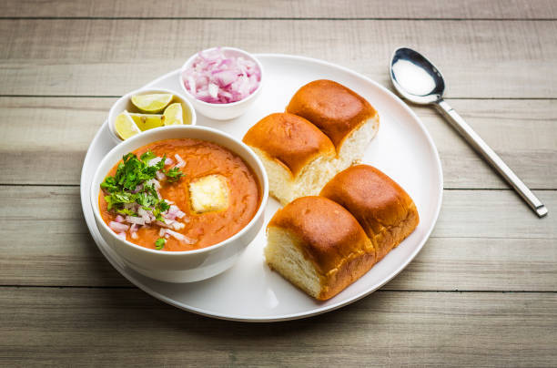
LET’S TAKE AN EXAMPLE ...
PAV BHAJI

Slide 4
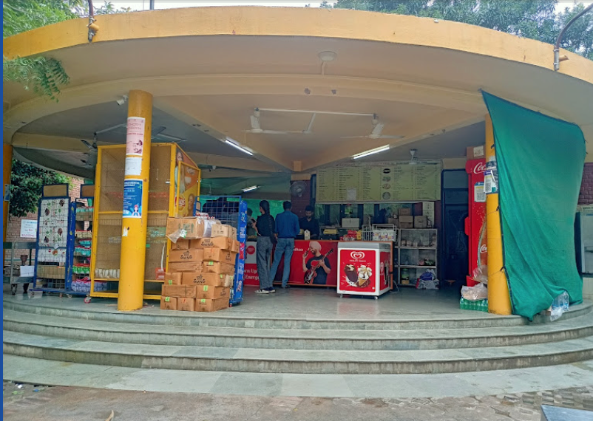
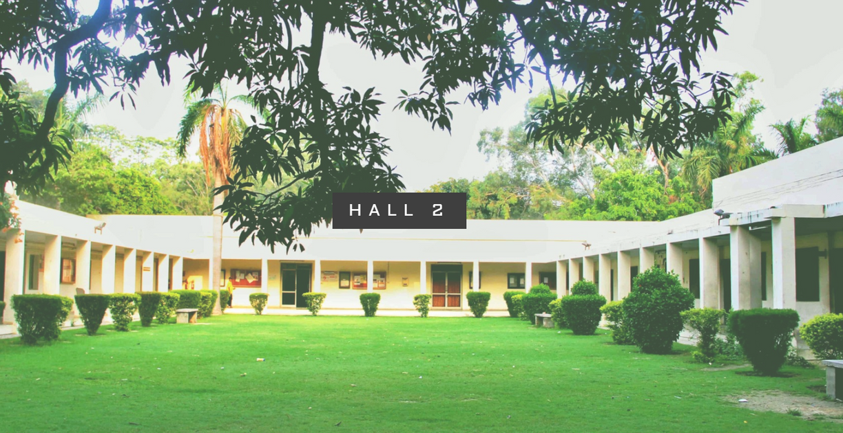
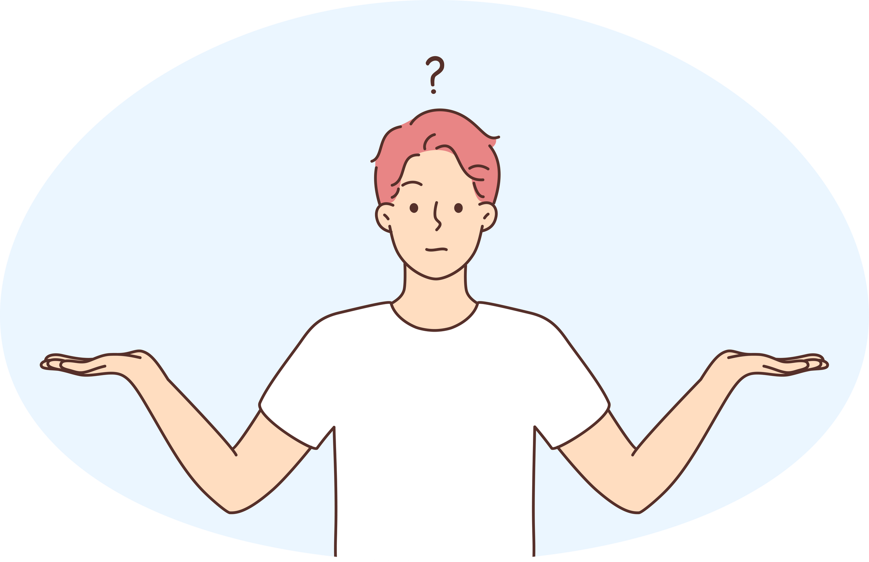
DOAA
HALL 2

Slide 5
Meet the
Team

Slide 6
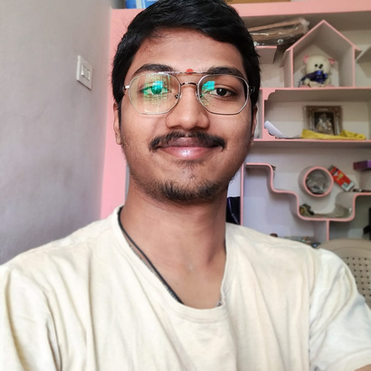
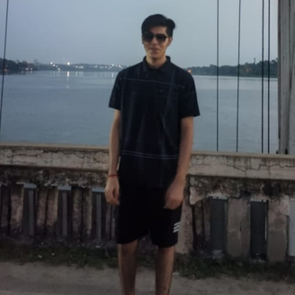
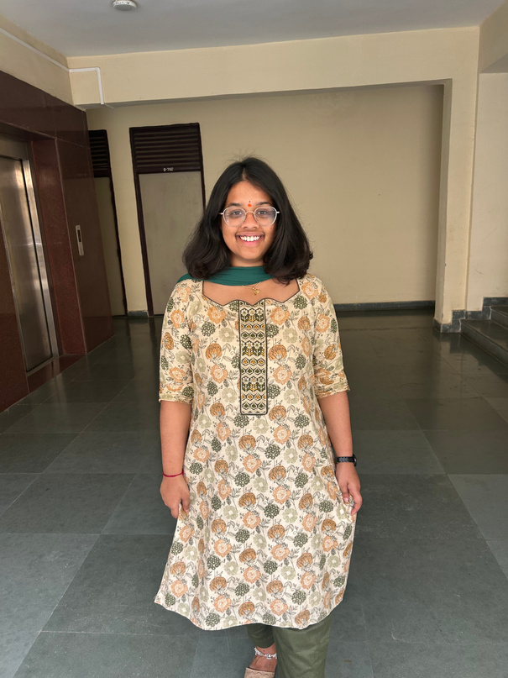
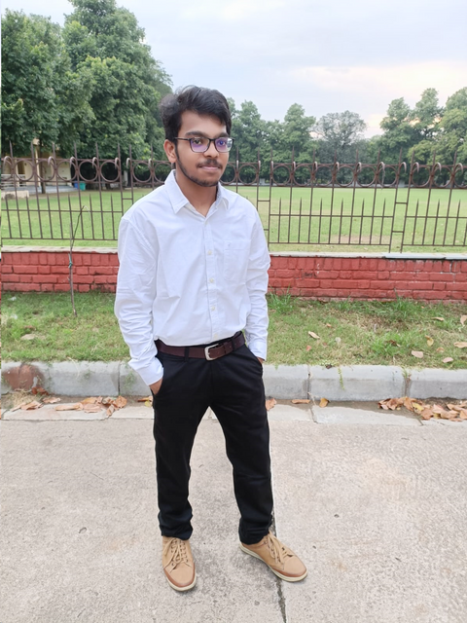
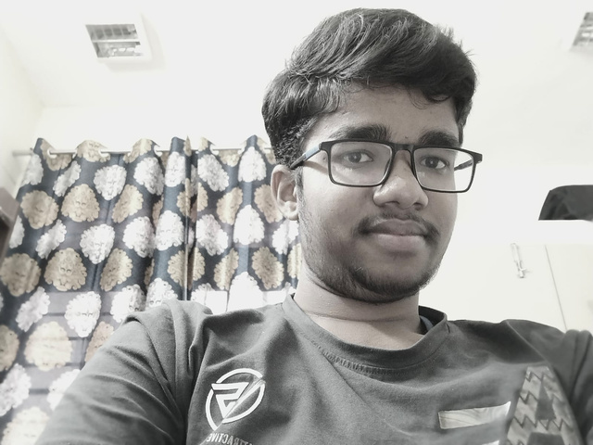
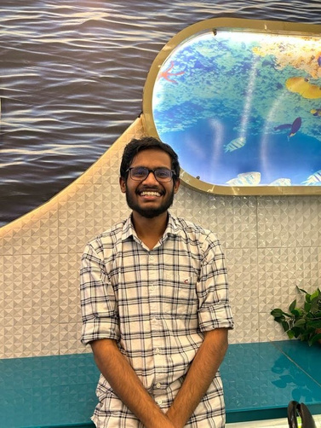
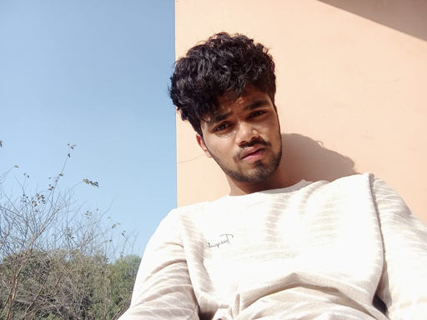


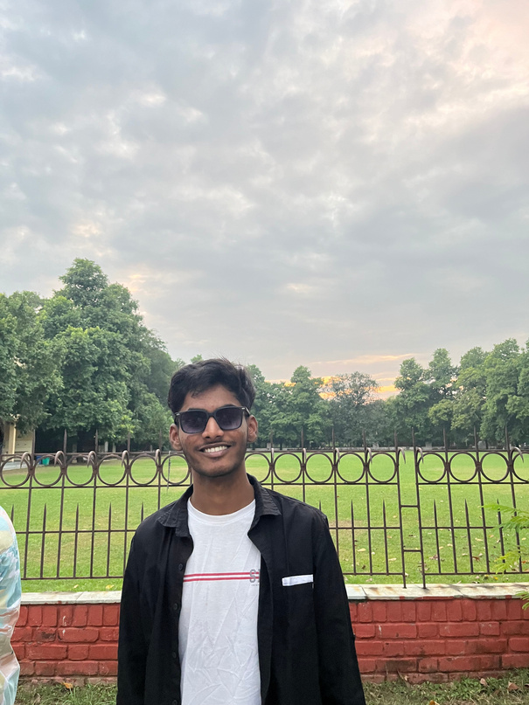

Rushikesh Chary
Raj Vinayak
Mahathi
Gowtham Chand
Bhanu Prakash
Harshith Sai
Rohan Aditya
Rithwin
Havish
Sai Dishanth
Vijay Kumar

Slide 7
Major
Requirements

Slide 8

Functional Requirements

Slide 9

User Account Management
Functional Requirements

Slide 10
User Account Management
Functional Requirements
Review & Rating System

Slide 11
User Account Management
Search Functionality
Functional Requirements
Review & Rating System

Slide 12
User Account Management
Search Functionality
Functional Requirements
Review & Rating System
User Interaction & Feedback

Slide 13







View/Add Reviews
View/Add Ratings
Registered User
Maintain Your Own Profile
Search Food

Slide 14
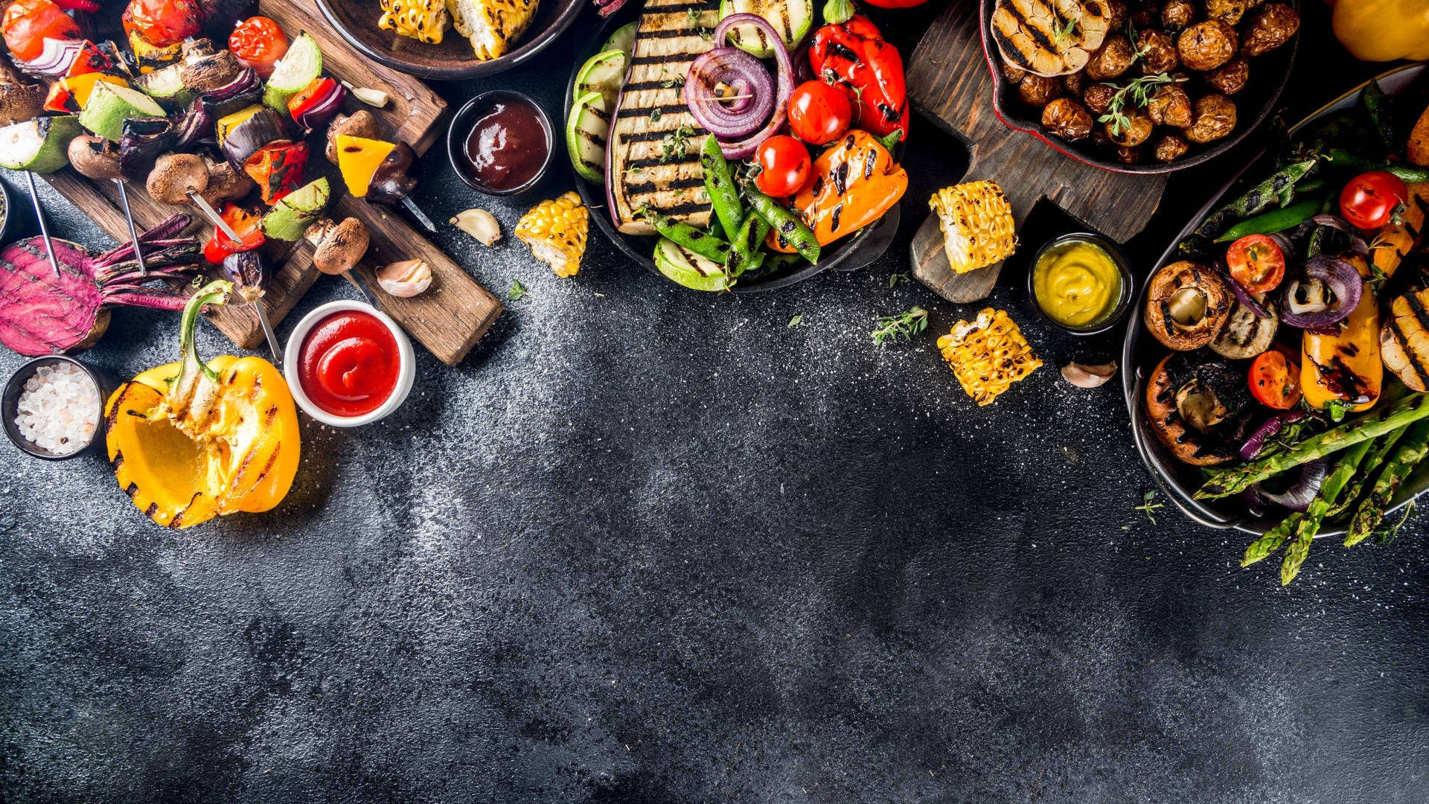




View Rating
View Reviews
NON-REGISTERED USER
Search Food

Slide 15
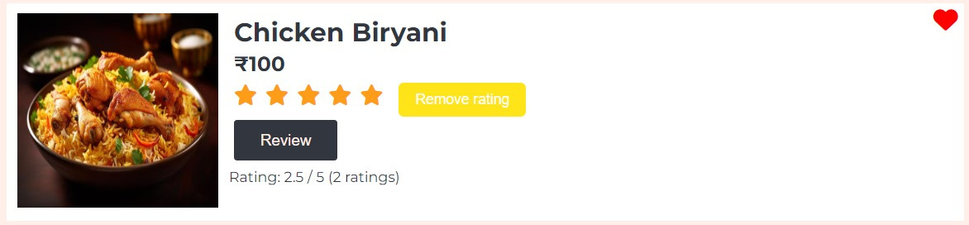
Rating & Review System

Slide 16
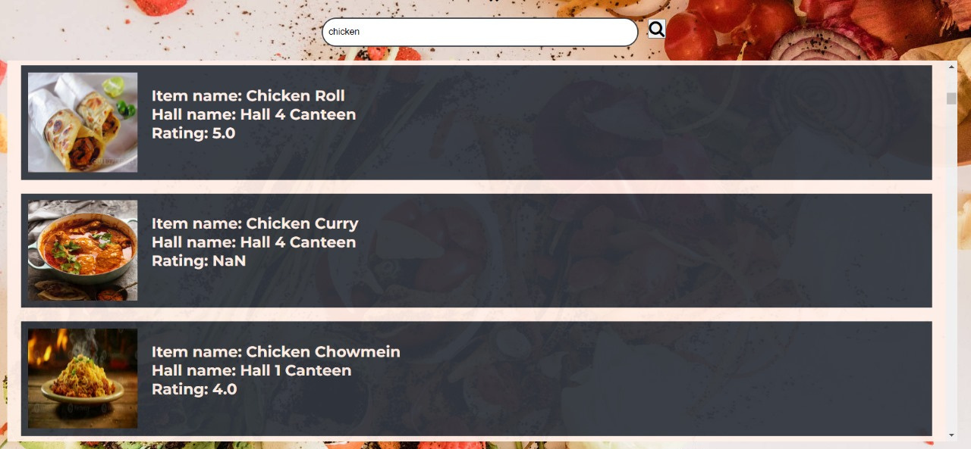
SEARCH FUNCTIONALITY

Slide 17
Key Design
Model
MODEL-VIEW-CONTROLLER
View
Handles data logic
Interacts with the database
Data base
Handles data presentations
Dynamically rendered
Fetch data
Controller
Fetch Presentation
Handles request flow
Specific Logic Data Validation

Slide 18

Implementation

Slide 19



Frontend

Slide 20

Backend
Node with Express
Database
MongoDB

Slide 21

Node with Express
Unified JavaScript Development
Simplified Routing and Middleware
Asynchronous and Non-blocking

Slide 22
MongoDB
Document Oriented Storage
Query capability and indexing
Scalability and Performance

Slide 23







Live Demo
https://knowyourcibo.onrender.com/

Slide 24
Future Development Plans

Slide 25

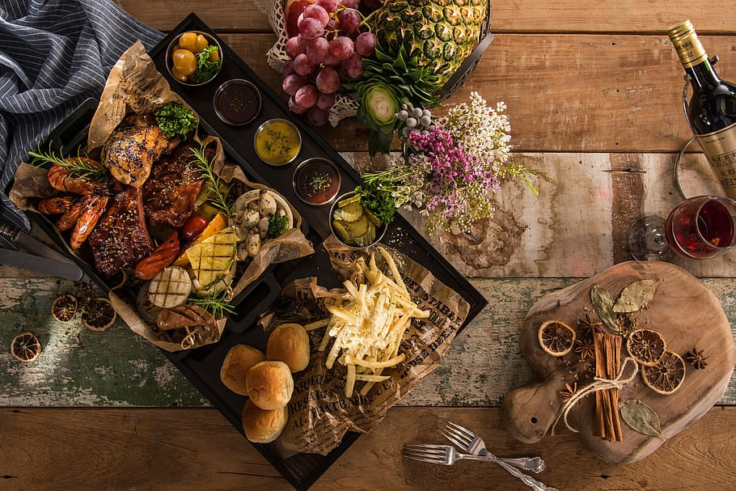
Future Development Plans
01
Responsiveness

Slide 26
Future Development Plans
01
Responsiveness
02
Promotion

Slide 27
Future Development Plans
01
Responsiveness
02
Promotion
03
Scalability

Slide 28
Future Development Plans
01
Responsiveness
02
Promotion
03
Scalability
04
Multilingualism

Slide 29
Future Development Plans
01
Responsiveness
02
Promotion
03
Scalability
04
Multilingualism
05
Food Preferences Sharing

Slide 30
Learning

Slide 31
THANK YOU !!

